Slide 1
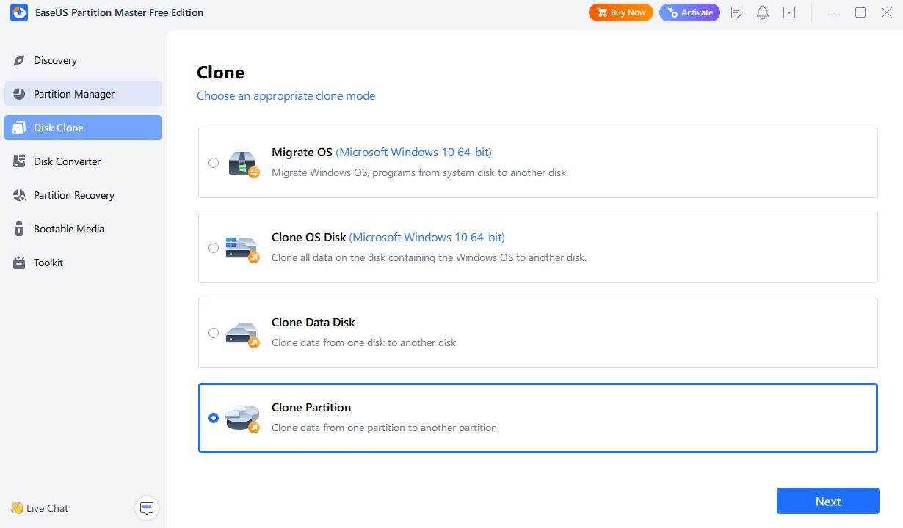
Step 1: in EaseUS partition master click on Disc Clone and select Clone Partition

Slide 2
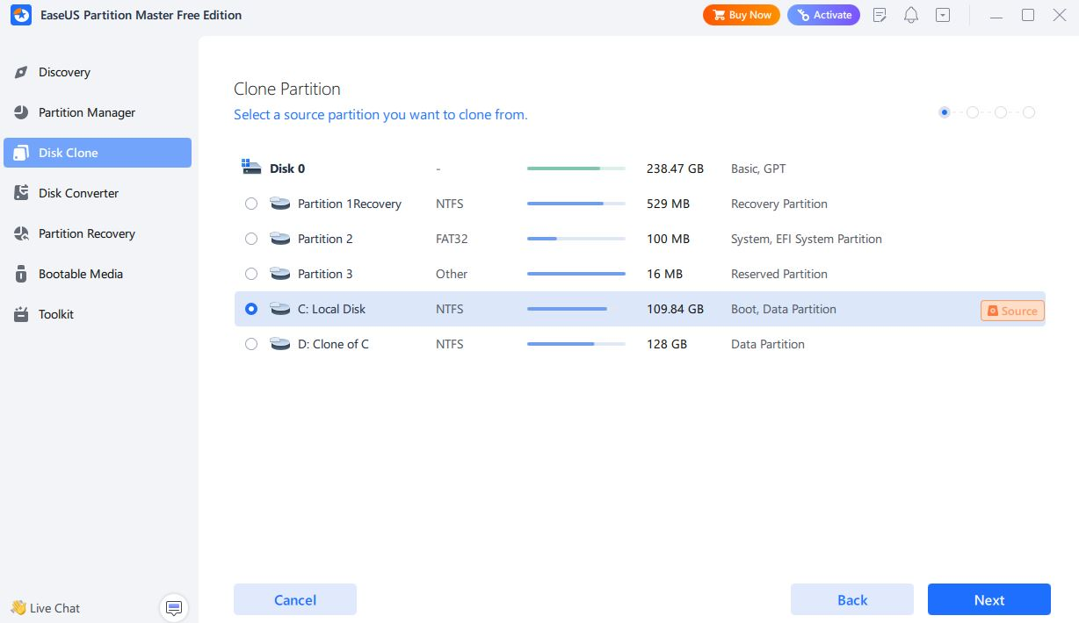
Step 2: Select the Disc partition you wish to clone and click next

Slide 3
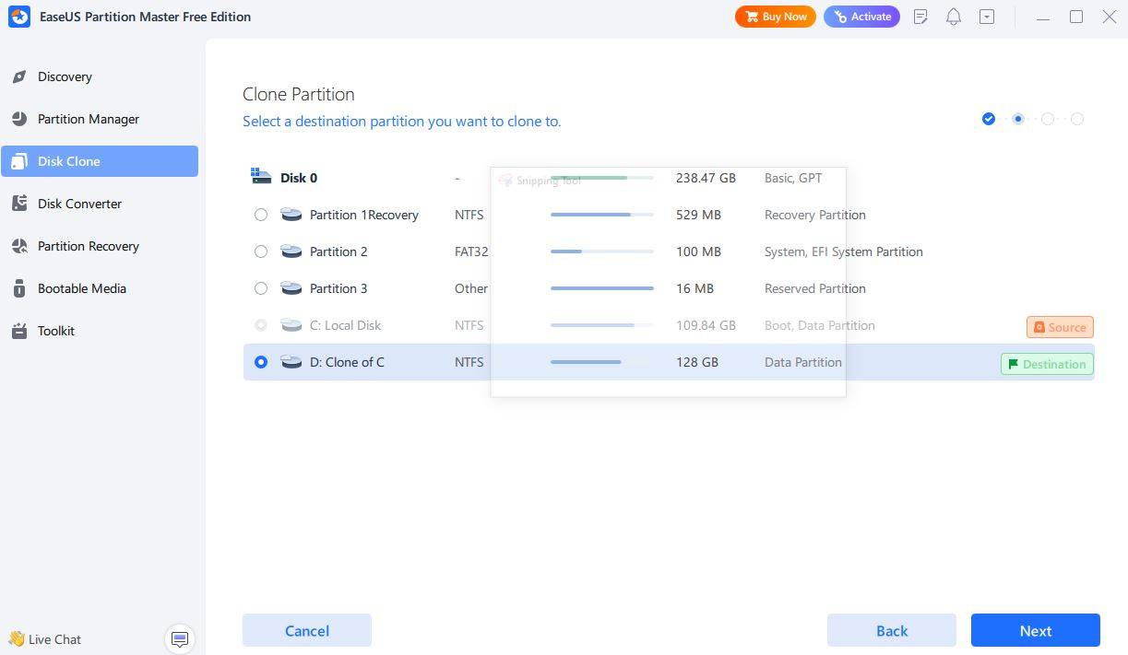
Step 3: Select the destination disc, where you wish to clone the disc to and click next

Slide 4
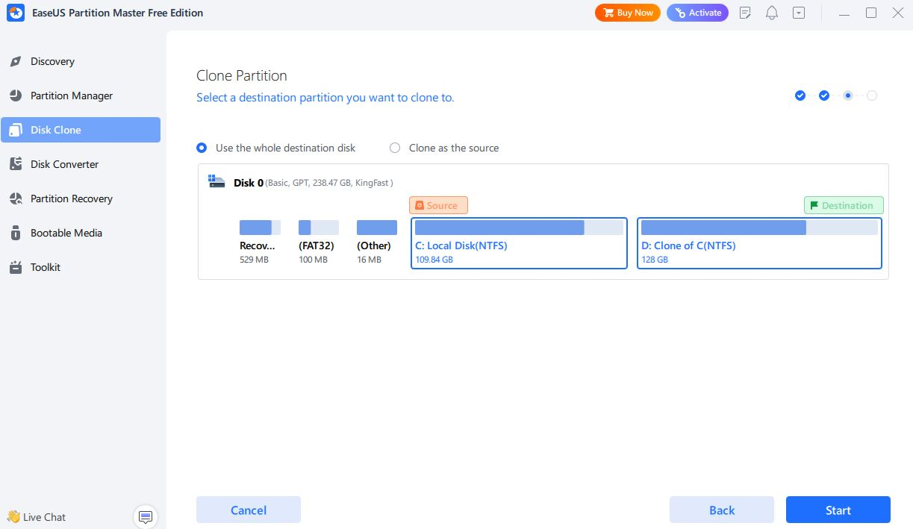
Step 5: Click on start to clone the disc partition

